Slide 1


BY CODEBASICS
AtliQ Hardware
Consumer Goods
Ad_Hoc_Insights
CREATED BY
Vishal Desai

Slide 2
BY CODEBASICS
AGENDA
BACKGROUND/CONTEXT
Getting Familiar With AtliQ-Business Model
1
2
3
4
Getting Familiar with input data
Ad-Hoc request along with Queried result, Visualization and Insides

Slide 3
BY CODEBASICS
Background/Context
Company
Problem
Background
Approach
AtliQ-Hardware (Imaginery Company) one of the leading Computer Hardware producers in India.
There are 10 ad-hoc requests for which the company needs insights.
Management noticed that do not got enough insights to make quick and smart data-informed decisions.
Run a SQL query to answer these requests. Convert it into visualizations and present the insights to the top-level management.

Slide 4
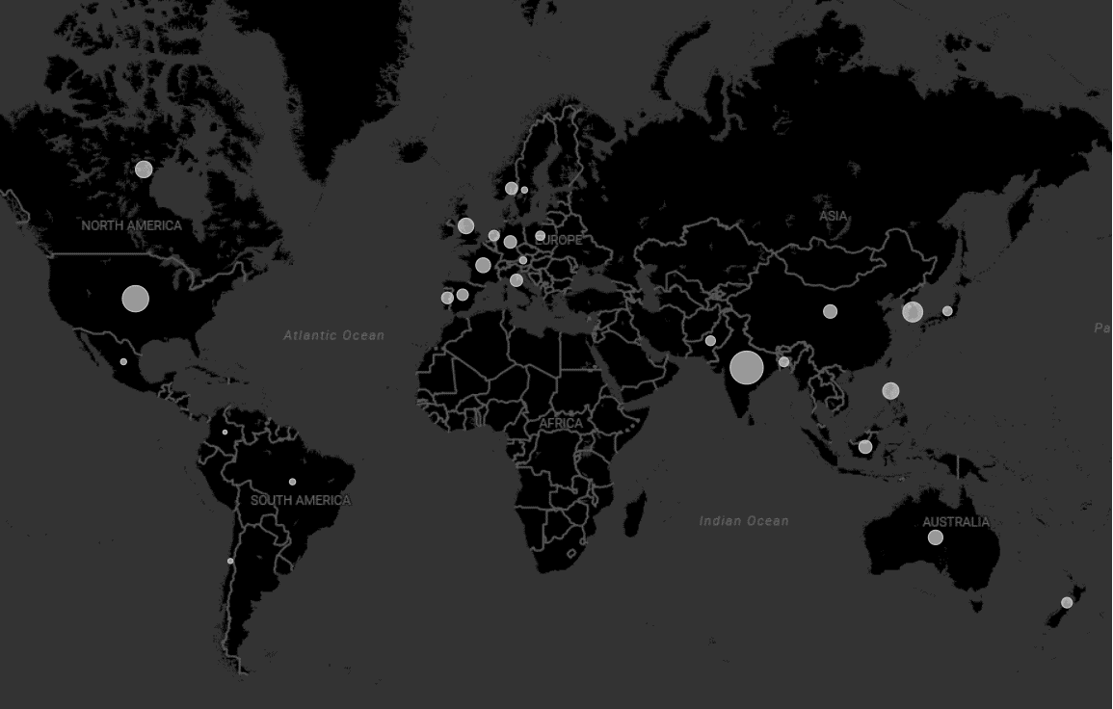
AtliQ’s Market
BY CODEBASICS

Slide 5
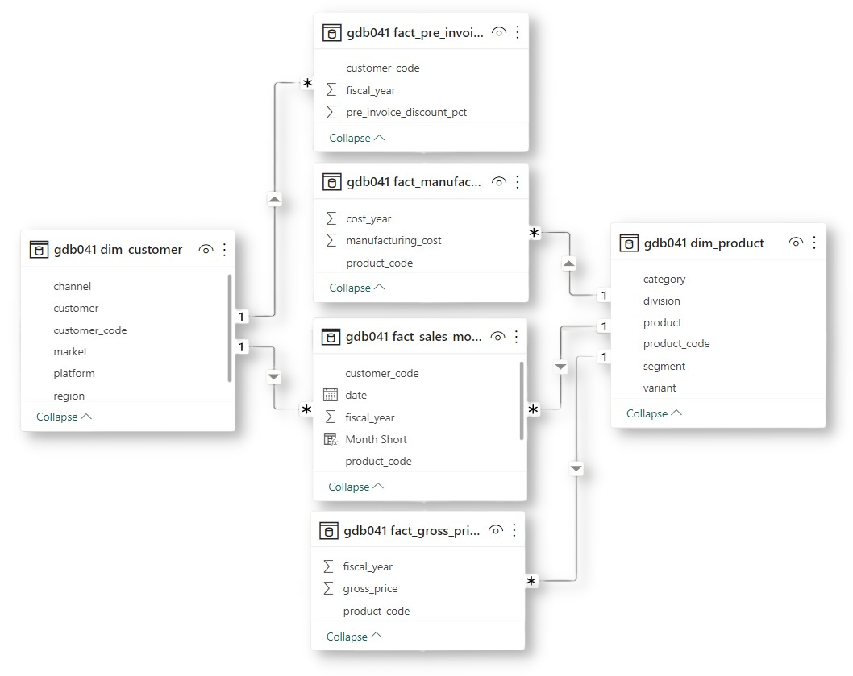
BY CODEBASICS
Getting Familiar with Input Data
Input Data consist of sales data for FY 2020 and FY 2021, along with different other dimension table like customer details and product details etc.

Slide 6
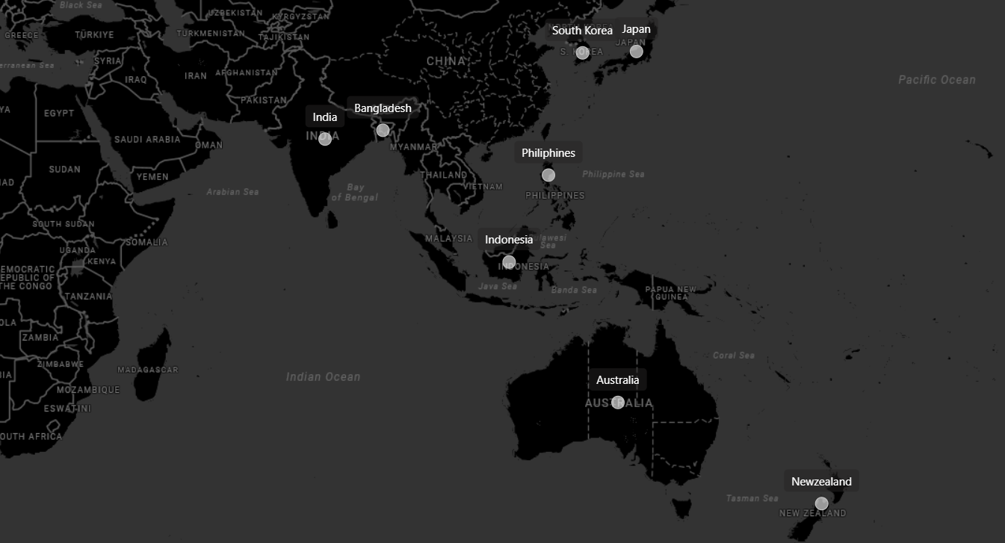
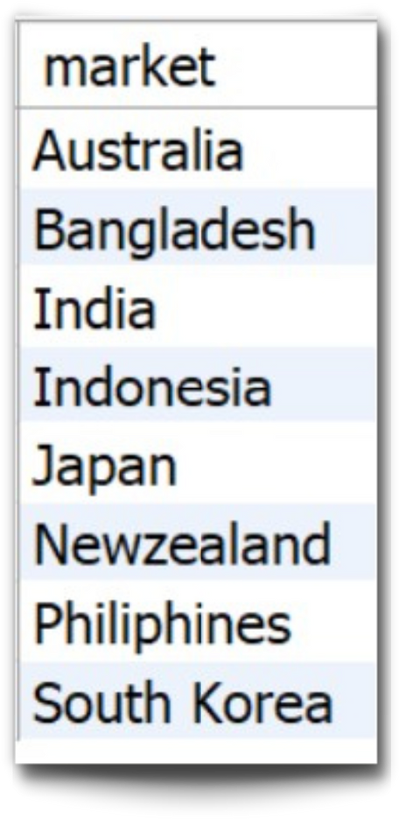
Request 1
Provide the list of markets in which customer "AtliQ Exclusive" operates its business in the APAC region.
BY CODEBASICS
Insights In the APAC region, AtliQ Exclusive store has established its presence in 8 major markets.

Slide 7
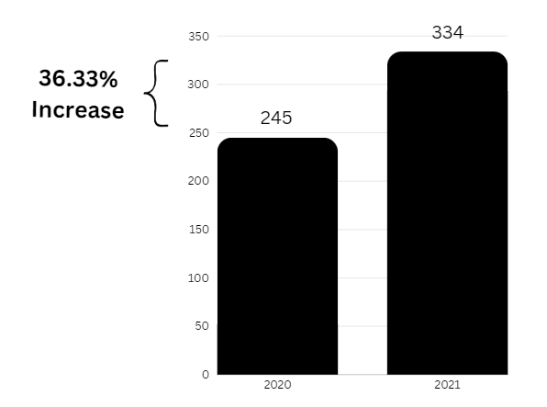
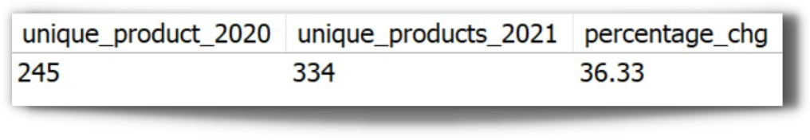
Request 2
What is the percentage of unique product increase in 2021 vs. 2020?
BY CODEBASICS
Insights
In the APAC region, AtliQ Exclusive store has established its presence in 8 major markets.

Slide 8
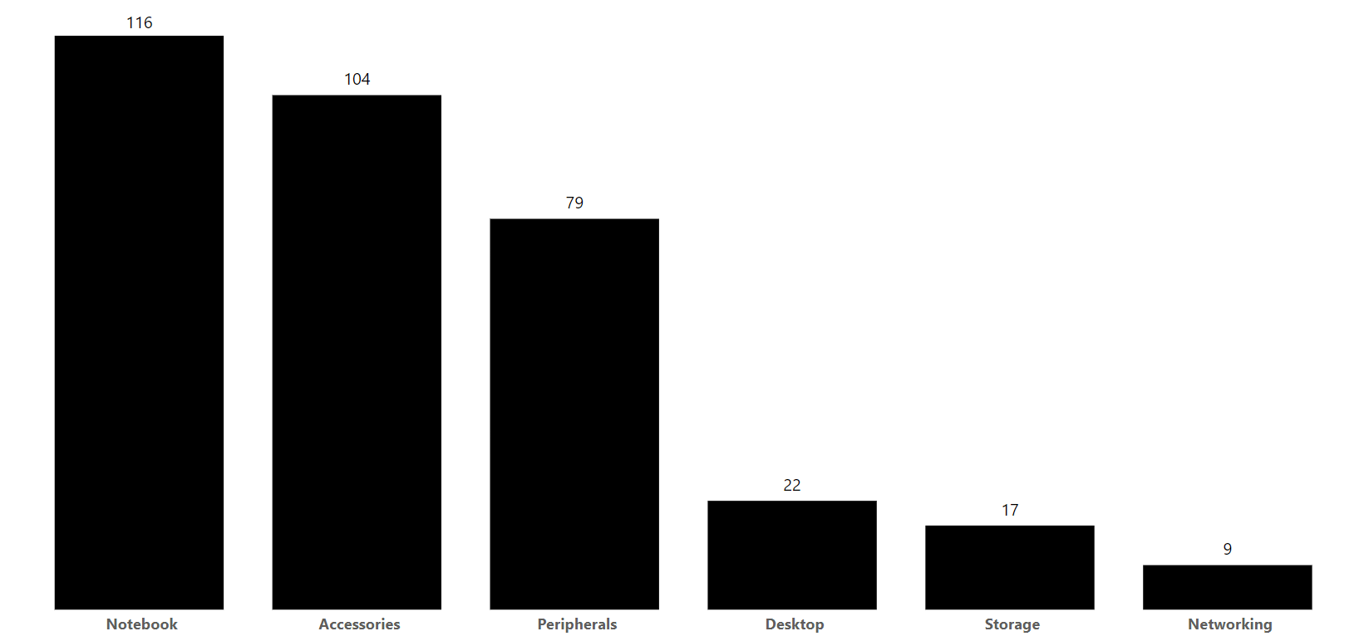
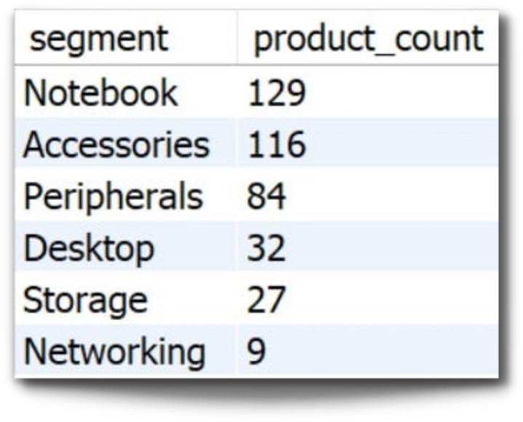
Request 3
Provide a report with all the unique product counts for each segment and sort them in descending order of product counts. The final output contains 2 fields ?,
BY CODEBASICS
Insights
Segments: notebooks, accessories, and peripherals are showing significant manufacturing growth as compared to desktops, storage, and networking.
Notebooks, accessories, and peripherals constitute 83% of the total manufactured product.

Slide 9
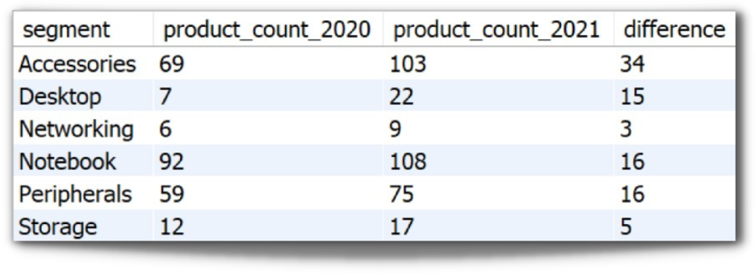
Request 4
Which segment had the most increase in unique products in 2021 vs 2020?
BY CODEBASICS
Insights
Accessories had the largest increase in production.
storage and Network are experiencing slower growth than other segments.

Slide 10
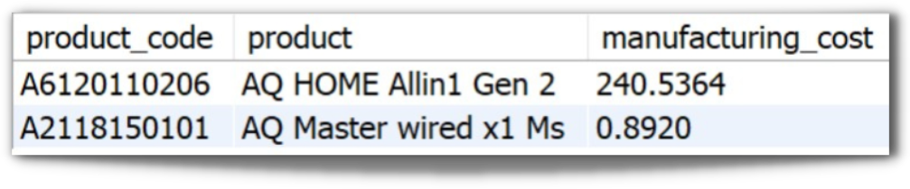


Request 5
Get the products that have the highest and lowest manufacturing costs ?
BY CODEBASICS
Product code and Product
Highest
Lowest
$240.53
$0.89
Insights
Mouse has a lowest manufacturing cost.
Personal Desktop has highest manufacturing cost.
AQ HOME Allin1 Gen 2
A6120110206
Personal Desktop
AQ Master wired x1 Ms
A2118150101
Mouse

Slide 11
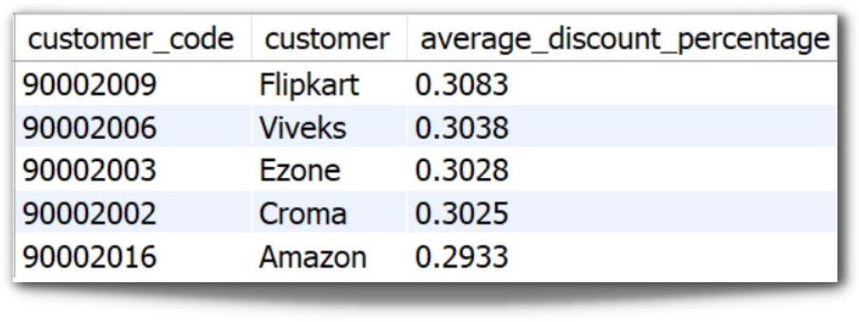
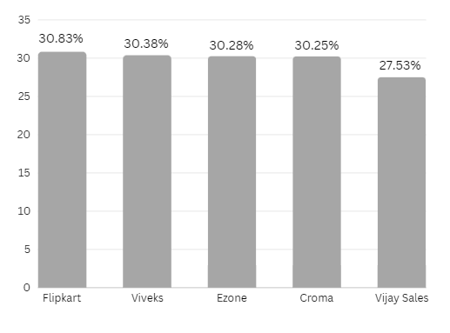
Request 6
Generate a report which contains the top 5 customers who received an average high pre_invoice_discount_pct for the fiscal year 2021 and in the Indian market ?
BY CODEBASICS
Insights
In 2021, we offered nearly equal pre-invoice discount percentage to each of out top 5 customers, gives that Flipkart is the most discounted customer in the Indian market, which equals 30.83%

Slide 12
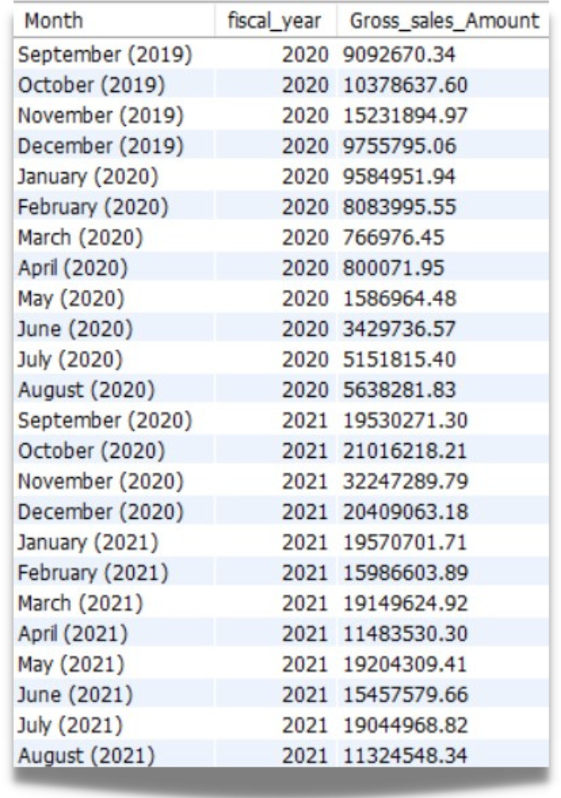
Request 7
Get the complete report of the Gross sales amount for the customer “AtliQ Exclusive” for each month. This analysis helps to get an idea of low and high-performing months and take strategic decisions ?
BY CODEBASICS
Insights
The lowest Gross sales total for both fiscal years is in March(2020)
The Highest Gross sales total for both fiscal years is in November(2020)

Slide 13
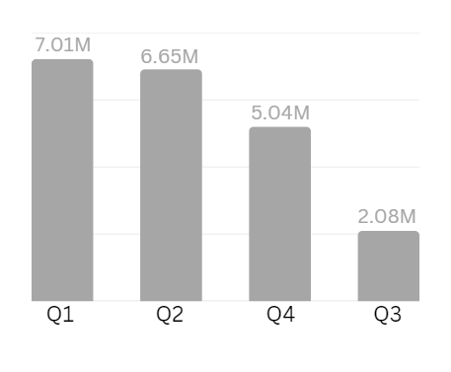
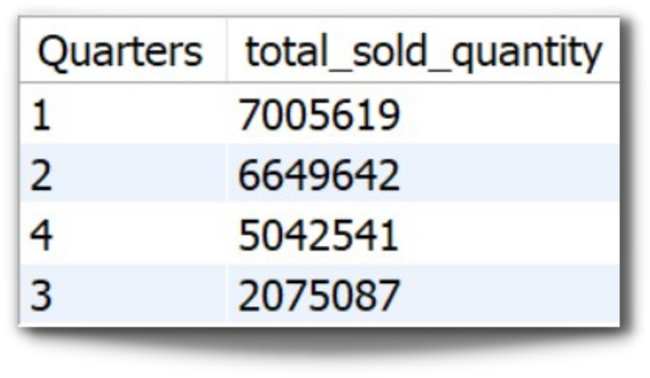
Request 8
In which quarter of 2020, got the maximum total_sold_quantity?
BY CODEBASICS
Insights
Quarter 1 of FY 2020 saw the most units sold overall, while Quarter 3 had the fewest.
The highest and lowest overall sold quantity is in December and March.

Slide 14
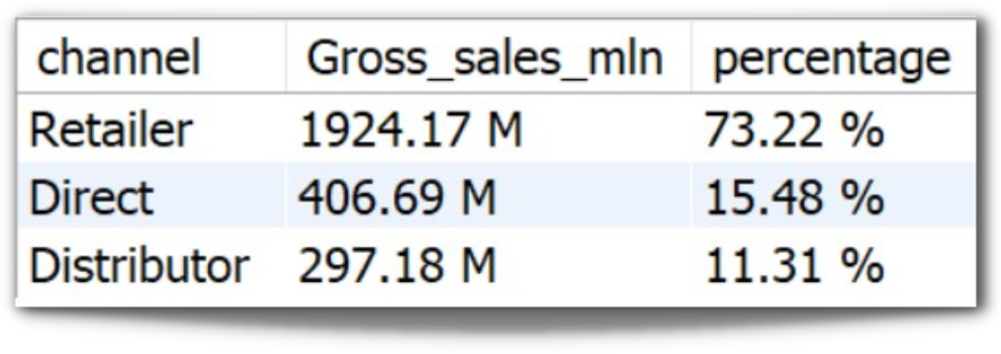
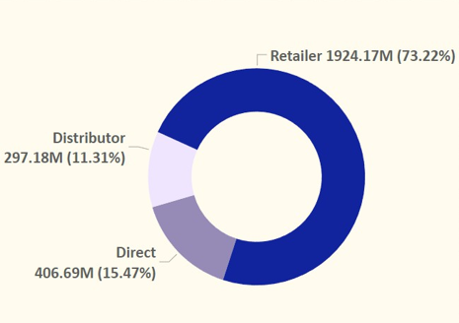
Request 9
Which channel helped to bring more gross sales in the fiscal year 2021 and the percentage of contribution?
BY CODEBASICS
Insights
Retailer are contributing highest that is (73.22%), to gross sales
Distributor are contributing around 15.48 % to gross sales
And remaining 11.31 % is contributed by Direct

Slide 15
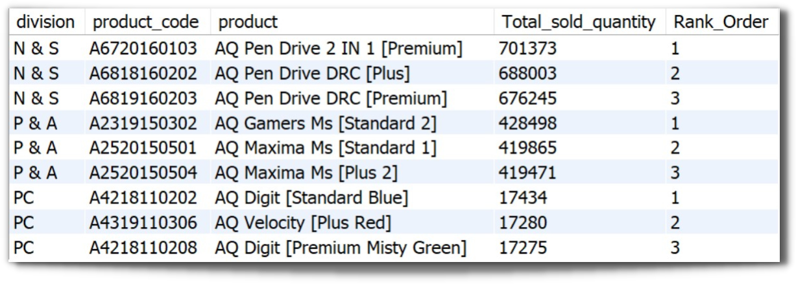
Request 10
Get the Top 3 products in each division that have a high total_sold_quantity in the fiscal year 2021 ??
BY CODEBASICS

Slide 16
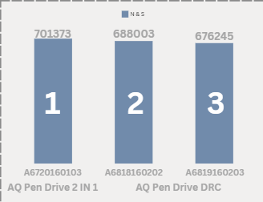
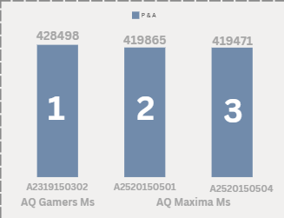
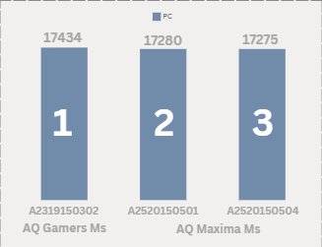
BY CODEBASICS
Premium
Plus
Premium
Standard
Blue
Red Plus
Premium Misty Green
Standard 2
Standard 2
Plus 1

Slide 17

Thank You

